Slide 1
Plan for Pointe Noire Disease Surveillance in R & ODK
Working proposal and aims

Slide 2
Currently:
Paper and photocopy based data entry and surveillance
Difficult to keep track of all forms
Difficult to visualise trends and new outbreaks
Forms often confusing and not filled in correctly
Time delay in reporting
Possible data loss in multiple photocopies
We found many forms which weren’t filled in correctly and were misclassified in physical form

Slide 3
Proposal
Train district focal points to use ODK Collect to gather information on
Acute Flaccid Paralysis
Measles
Yellow Fever
ODK can also be used to collect geopositional data
This data is uploaded to a central Pointe Noire server, or initially a Google Sheets account owned by Dr Conde.
This data can then be pulled from Google Sheets automatically and create reports on numbers of cases/other information using R Markdown and feed into a dashboard for geospatial and incidence visualisation using RShiny SpatialEpiApp

Slide 4

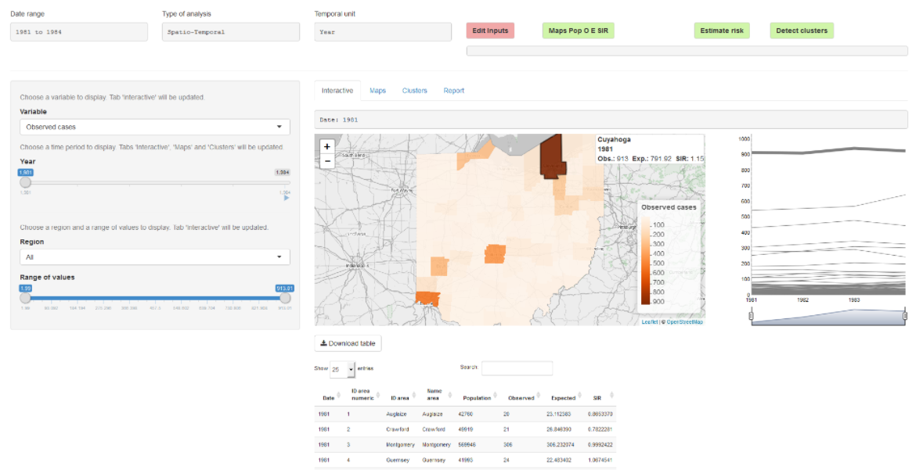









Diagram
SpatialEpiApp for visualisation
7 x District ODK Collect Users
Automated reporting in rmarkdown
using knitr to write pdf/html

Slide 5
Working Plan
Create ODK Forms for Disease Notification + train staff in use
Set upload to Google Sheets (possibility to move to ODK Central)
Write R Script to pull this data for analysis
Setup R Markdown to write reports on run
Import data into GeoSpatial RShiny App
Train local staff to take over project independently of World Health Organisation in future

Slide 6
References
Allaire, JJ, Yihui Xie, Jonathan McPherson, Javier Luraschi, Kevin Ushey, Aron Atkins, Hadley Wickham, Joe Cheng, Winston Chang, and Richard Iannone. 2019. Rmarkdown: Dynamic Documents for R. https://CRAN.R-project.org/package=rmarkdown.
Kulldorff, Martin. 2006. “SaTScan(TM) V. 7.0. Software for the Spatial and Space-Time Scan Statistics.” http://www.satscan.org.
Moraga, Paula. 2017a. “SpatialEpiApp: A Shiny Web Application for the analysis of Spatial and Spatio-Temporal Disease Data.” Spatial and Spatio-Temporal Epidemiology 23: 47–57. doi:https://doi.org/10.1016/j.sste.2017.08.001.
Moraga, Paula. 2017b. SpatialEpiApp: A Shiny Web Application for the Analysis of Spatial and Spatio-Temporal Disease Data. https://CRAN.R-project.org/package=SpatialEpiApp.
RStudio Team (2020). RStudio: Integrated Development for R. RStudio, PBC, Boston, MA URL http://www.rstudio.com/.

